Slide 1
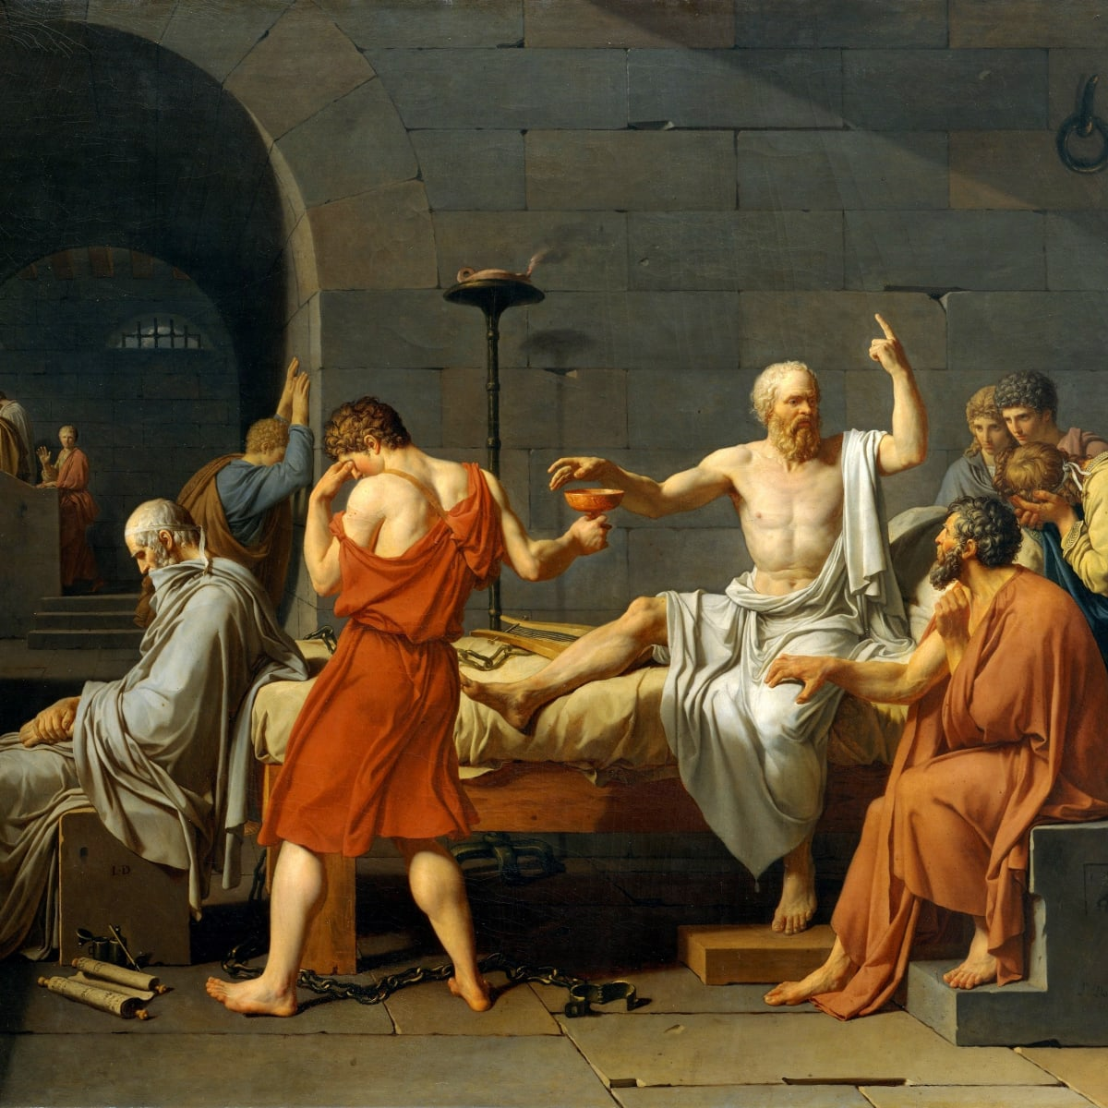
The Wisdom of Socrates
“I know I know nothing.”
- Plato quoting his teacher Socrates. This is known as the Socratic Paradox.

Slide 2
Socrates is most well known for the creation of the Socratic Method. The Socratic
Method is a dialogue between teacher and students, instigated by the continual
probing questions of the teacher, in an effort to explore the underlying beliefs
that shape the students’ views.

Slide 3
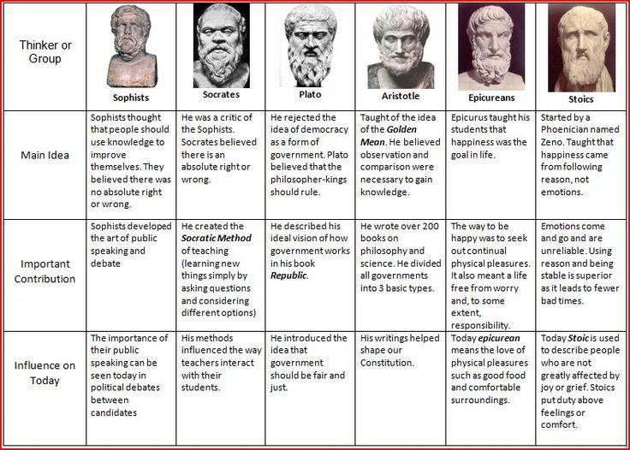

Slide 4
Quote Protocol
With your groups, read the quotes from famous Greek philosophers on the following slides.
These individuals lived during the 5th century BCE from (500-401 BCE) and wanted to understand life using skills like reason, logic and observation .
Though many of them were polytheists who believed in the gods and goddesses of Mt. Olympus, they also argued that man could find moral meaning through intentional exploration and discovery.
Discuss the following questions with your groups!
1. What connections can be made between these quotes and other religions/philosophies?
2. Do these quotes still hold relevance in today’s complicated world?

Slide 5
Quote Analysis
"Everything flows, and nothing abides, everything gives way, and nothing stays fixed."-Heraclitus
"What you leave behind is not what is engraved in stone monuments, but what is woven into the lives of others."-Pericles
”The unexamined life is not worth living."-Socrates
"Quality is not an act, it is a habit."-Aristotle

Slide 6
Quote Analysis
“Different men seek after happiness in different ways and by different means, and so make for themselves different modes of life and different forms of government.”- Aristotle
“For a man to conquer himself is the first and noblest of all victories .” Plato
“If you do not take an interest in the affairs of your government , then you are doomed to live under the rule of fools.”- Plato

Slide 7

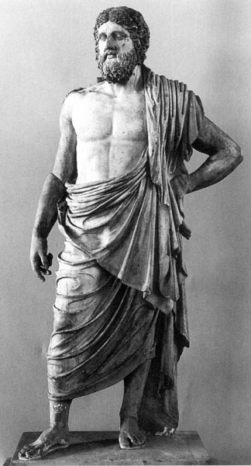
Staten Island Tech Philosophers
It is time for you to ascend to enlightenment, put on your himation (Greek robes) and become a Greek Philosopher!
Go back and review the previous information and quotes. With the help of your group, create two quotes of your own philosophical wisdom. Write your quotes on your whiteboard.
Your quote can be based on education, morality, civics, government, society, time, the individual, the soul or other topics you think are relevant. Feel free to relate your quote to your own daily life!

